Slide 1

ANALYSIS OF CAR PRICES
By Nurul Saidi

Slide 2
Methods
Identify the driven factors for car pricing.
Determine the current pricing setting in the market
Ideal price settings.
Notes:
B1 : Current Price level
- Price differentiation based on products/year/manufacturer
B2 : Which factors drive the pricing of the cars?
-Dependent Variable : MSPR
Independent Variables : Numerical and Categorical Variables
B3: What is the ideal price, given the technical aspects, the period of the year, target customer and the brand itself?

Slide 3
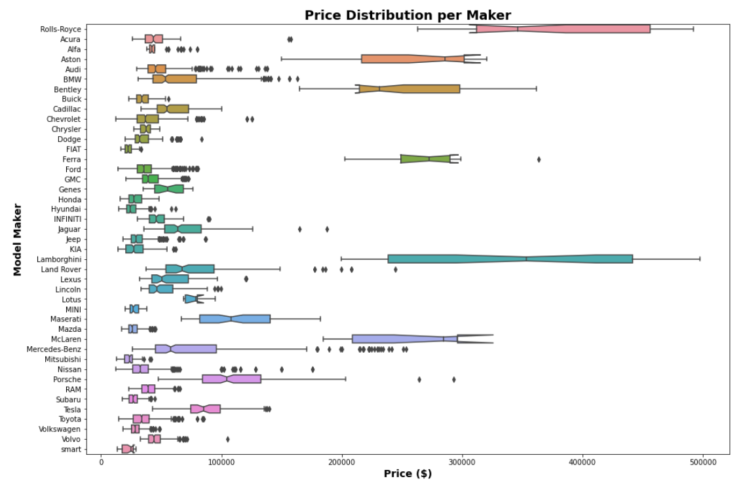
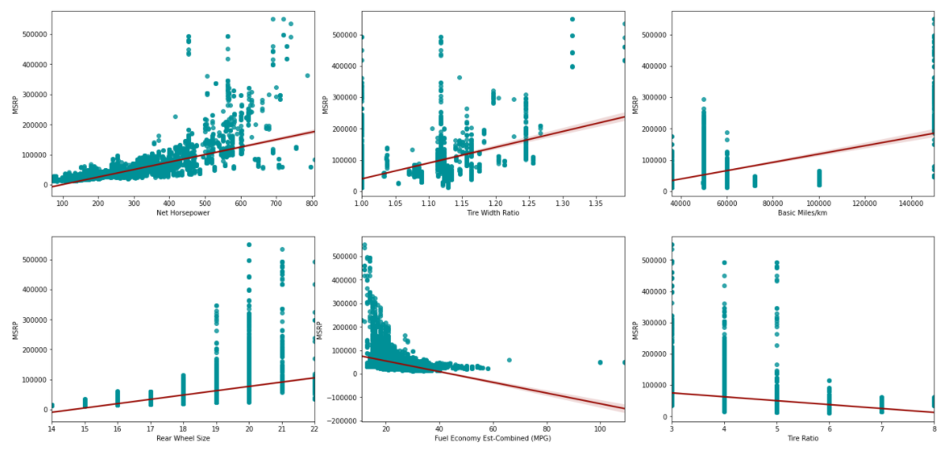
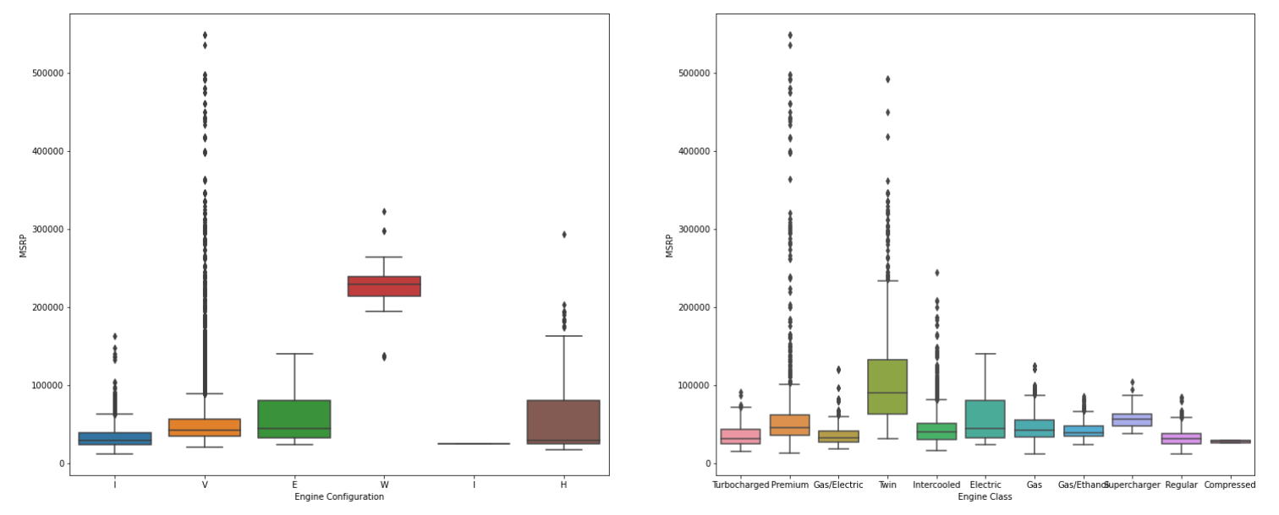
Our Findings
Our Pricing Drivers

Slide 4
Conclusions
The identified main driven factors represents the size / engine power of the car.
The manufacturer brand also important in driving the pricing value, where luxury car maker tends to price on the higher end as compared the average car value in the market.
Reasonable approach : Determine predicted car prices using regression model and compare against current car prices for clearer view on the current pricing level either it is: ideal, Overpriced or Underpriced.

